Slide 1
Analysis of A-planet experiment

Slide 2
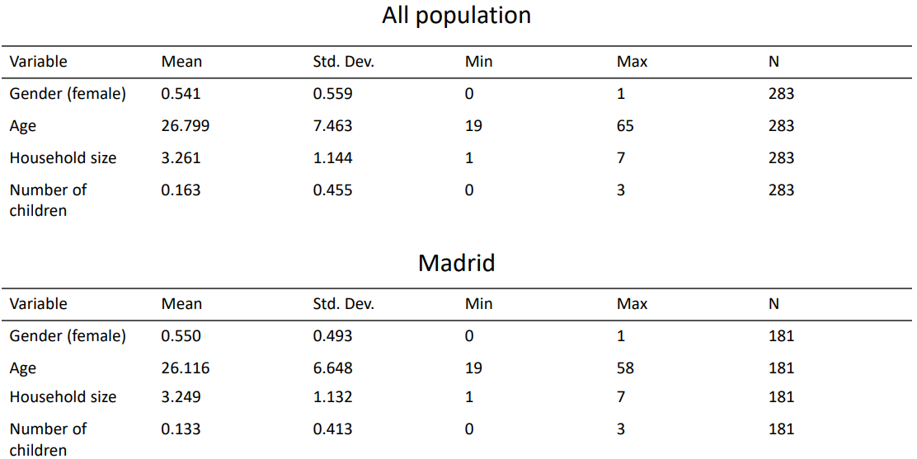
Summary statistics
In the following analysis, we only kept the participants living in Madrid

Slide 3
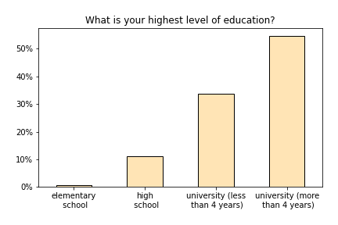
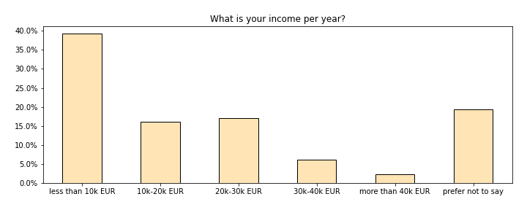

Slide 4
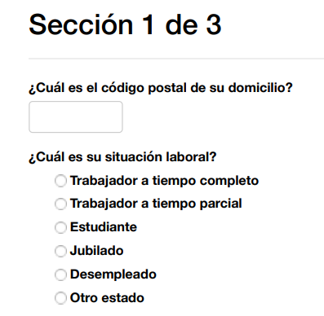
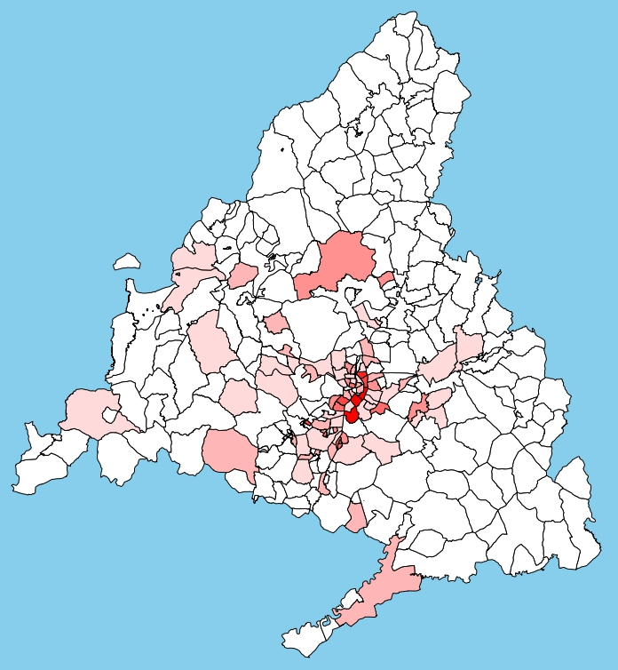
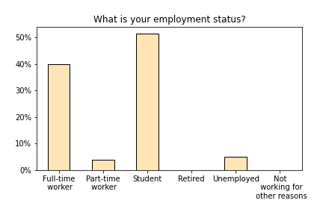
Map of participants’ domicile based on postal code:

Slide 5
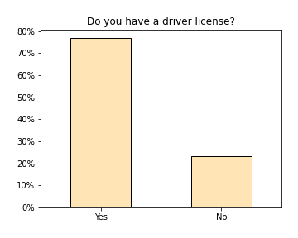
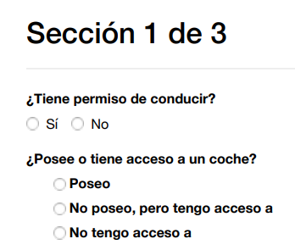
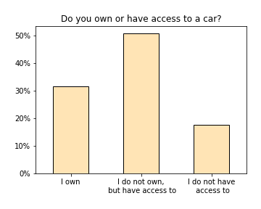

Slide 6
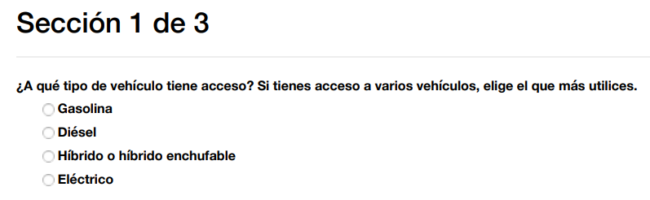
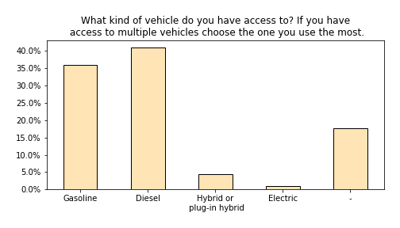

Slide 7
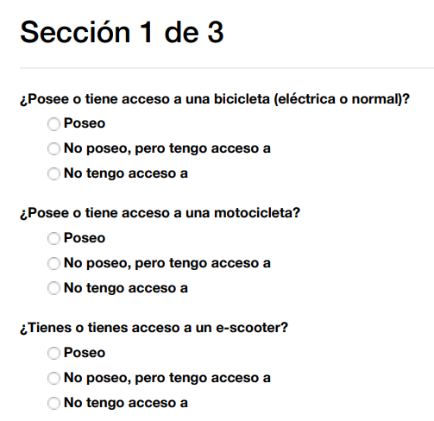
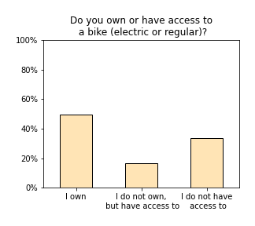
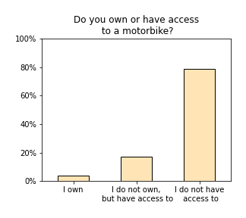
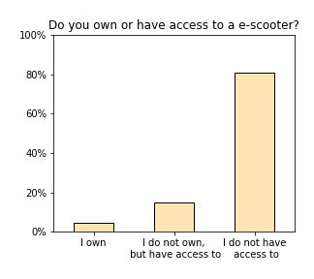

Slide 8
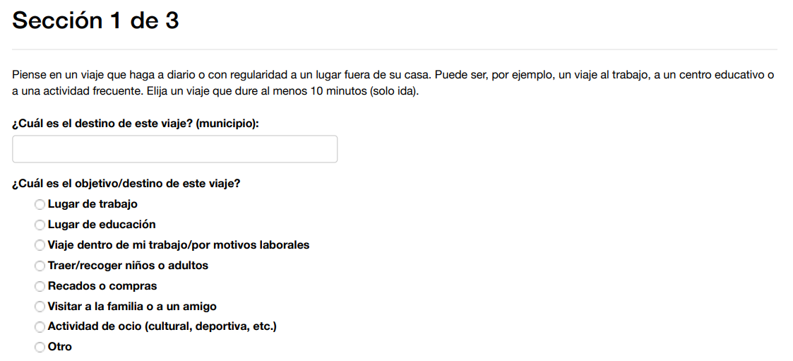
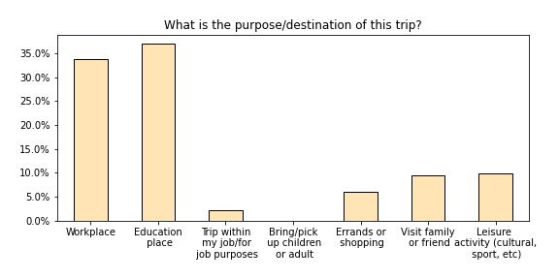
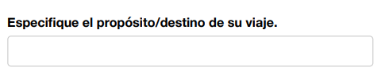

Slide 9
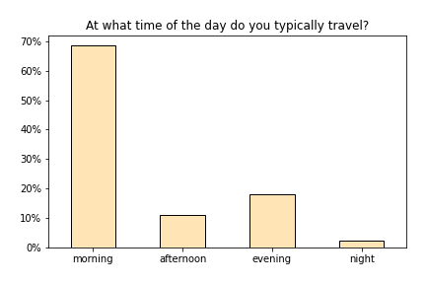
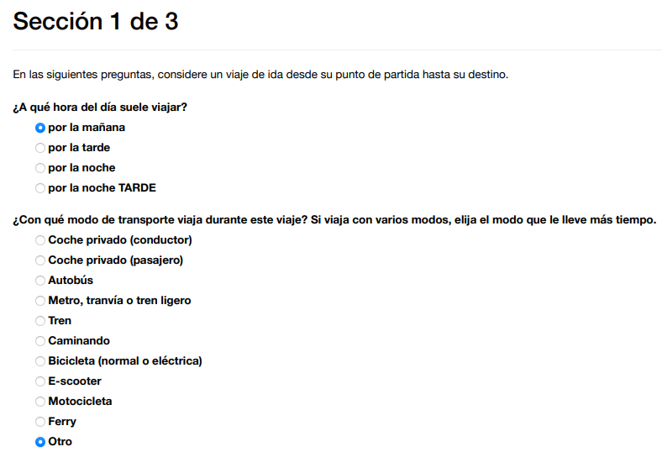
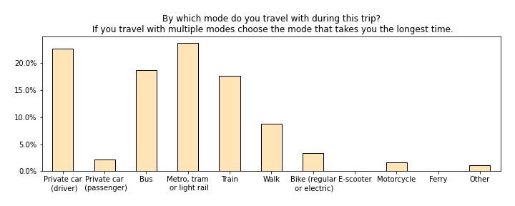
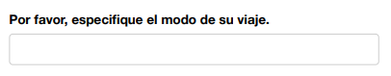

Slide 10
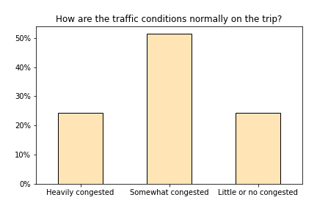
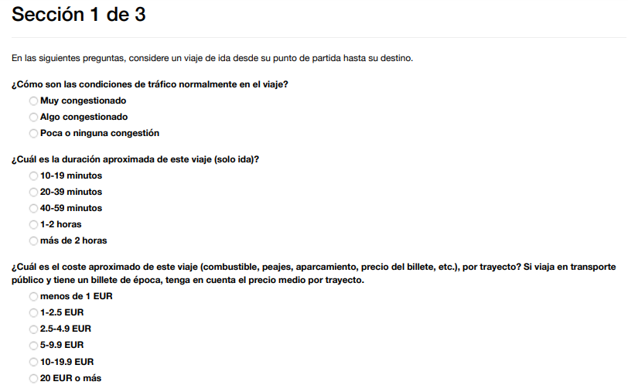
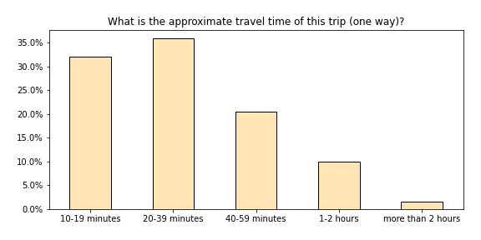

Slide 11
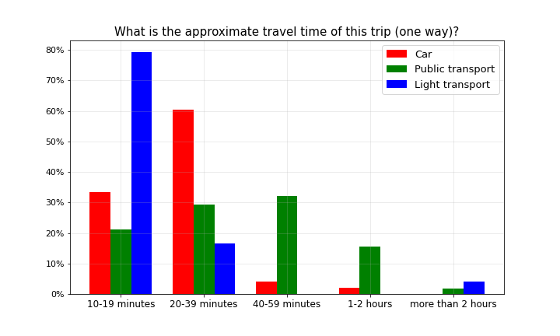
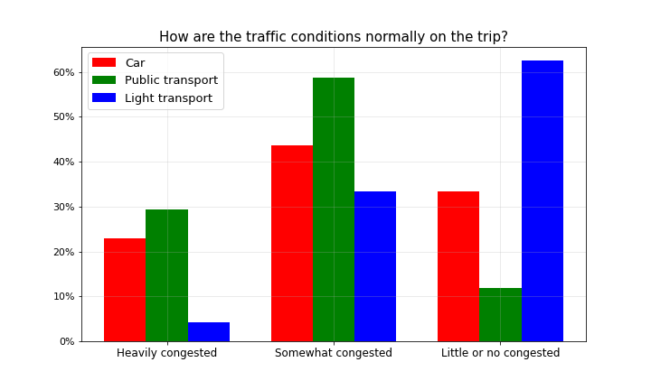
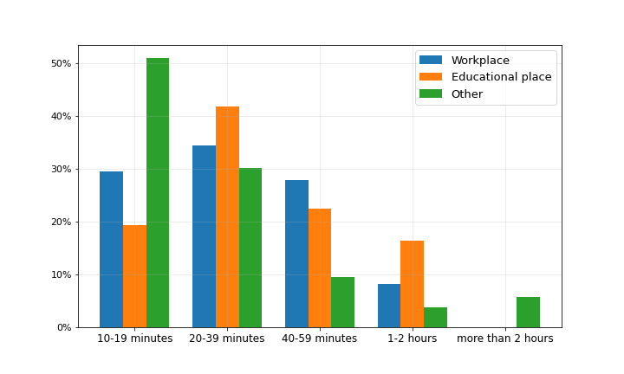

Slide 12
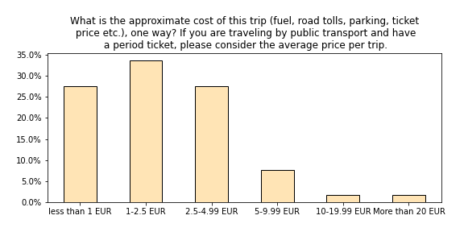

Slide 13
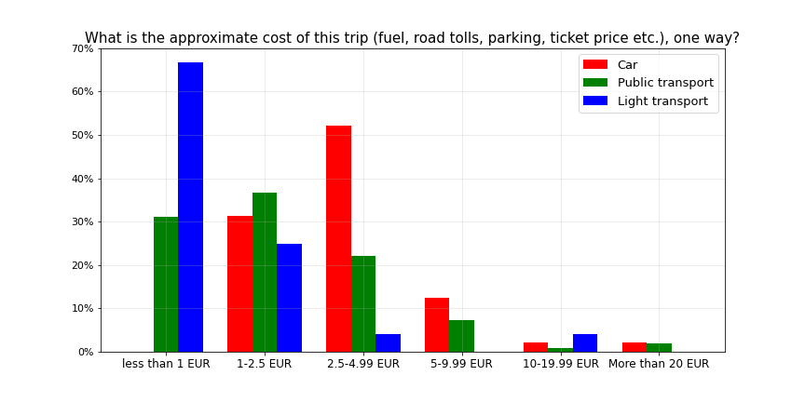

Slide 14
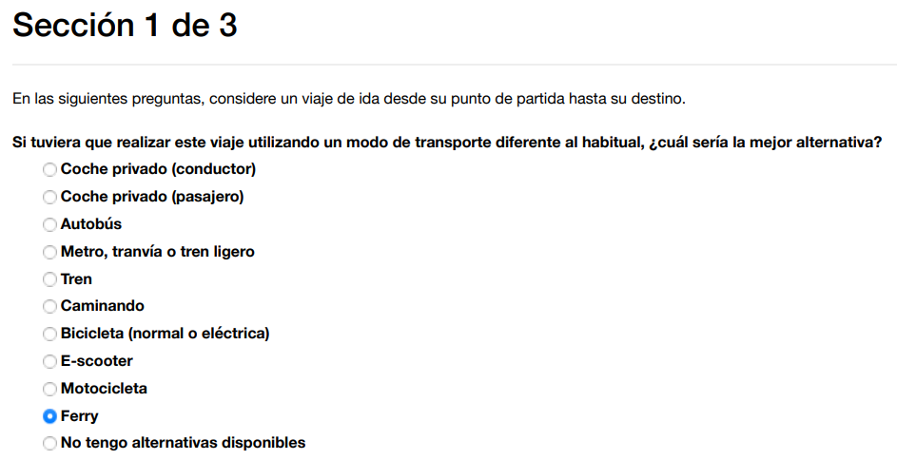
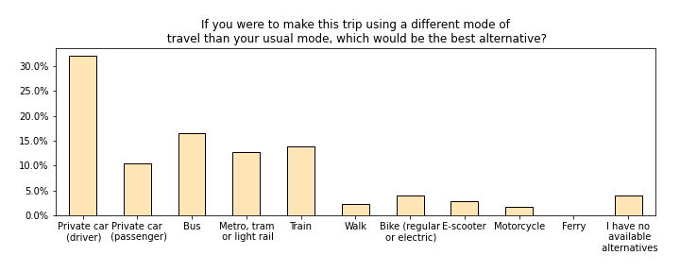
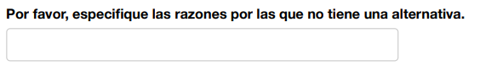

Slide 15
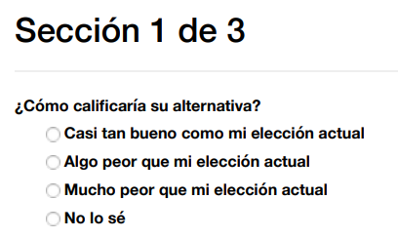
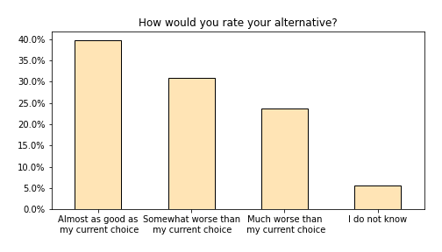

Slide 16
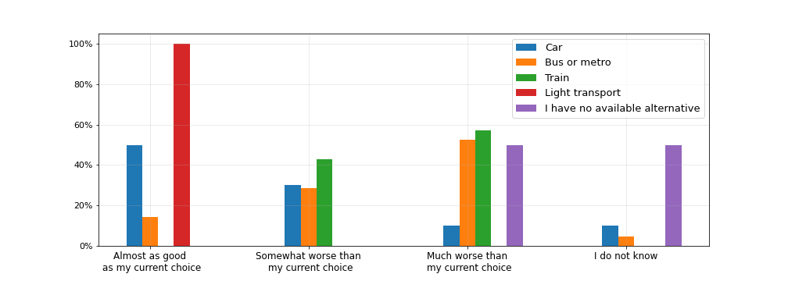
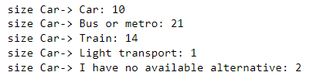
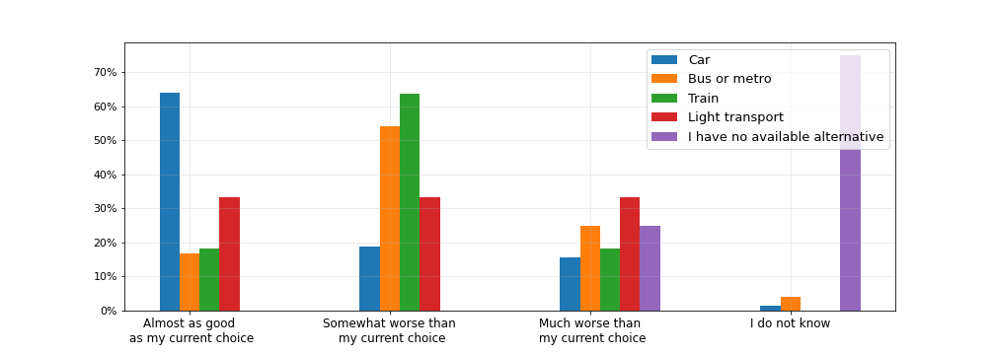
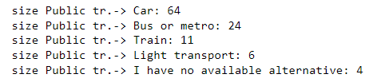
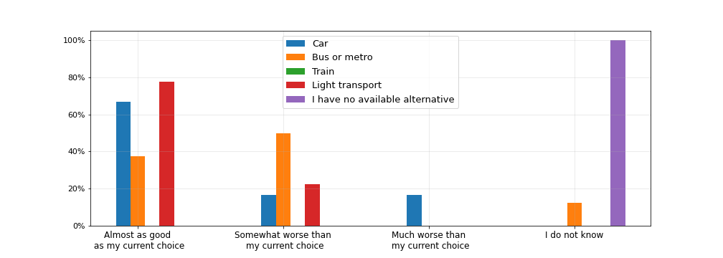
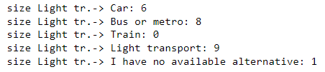
← From “Car”
From “Public transport” →
← From “Light transport”

Slide 17
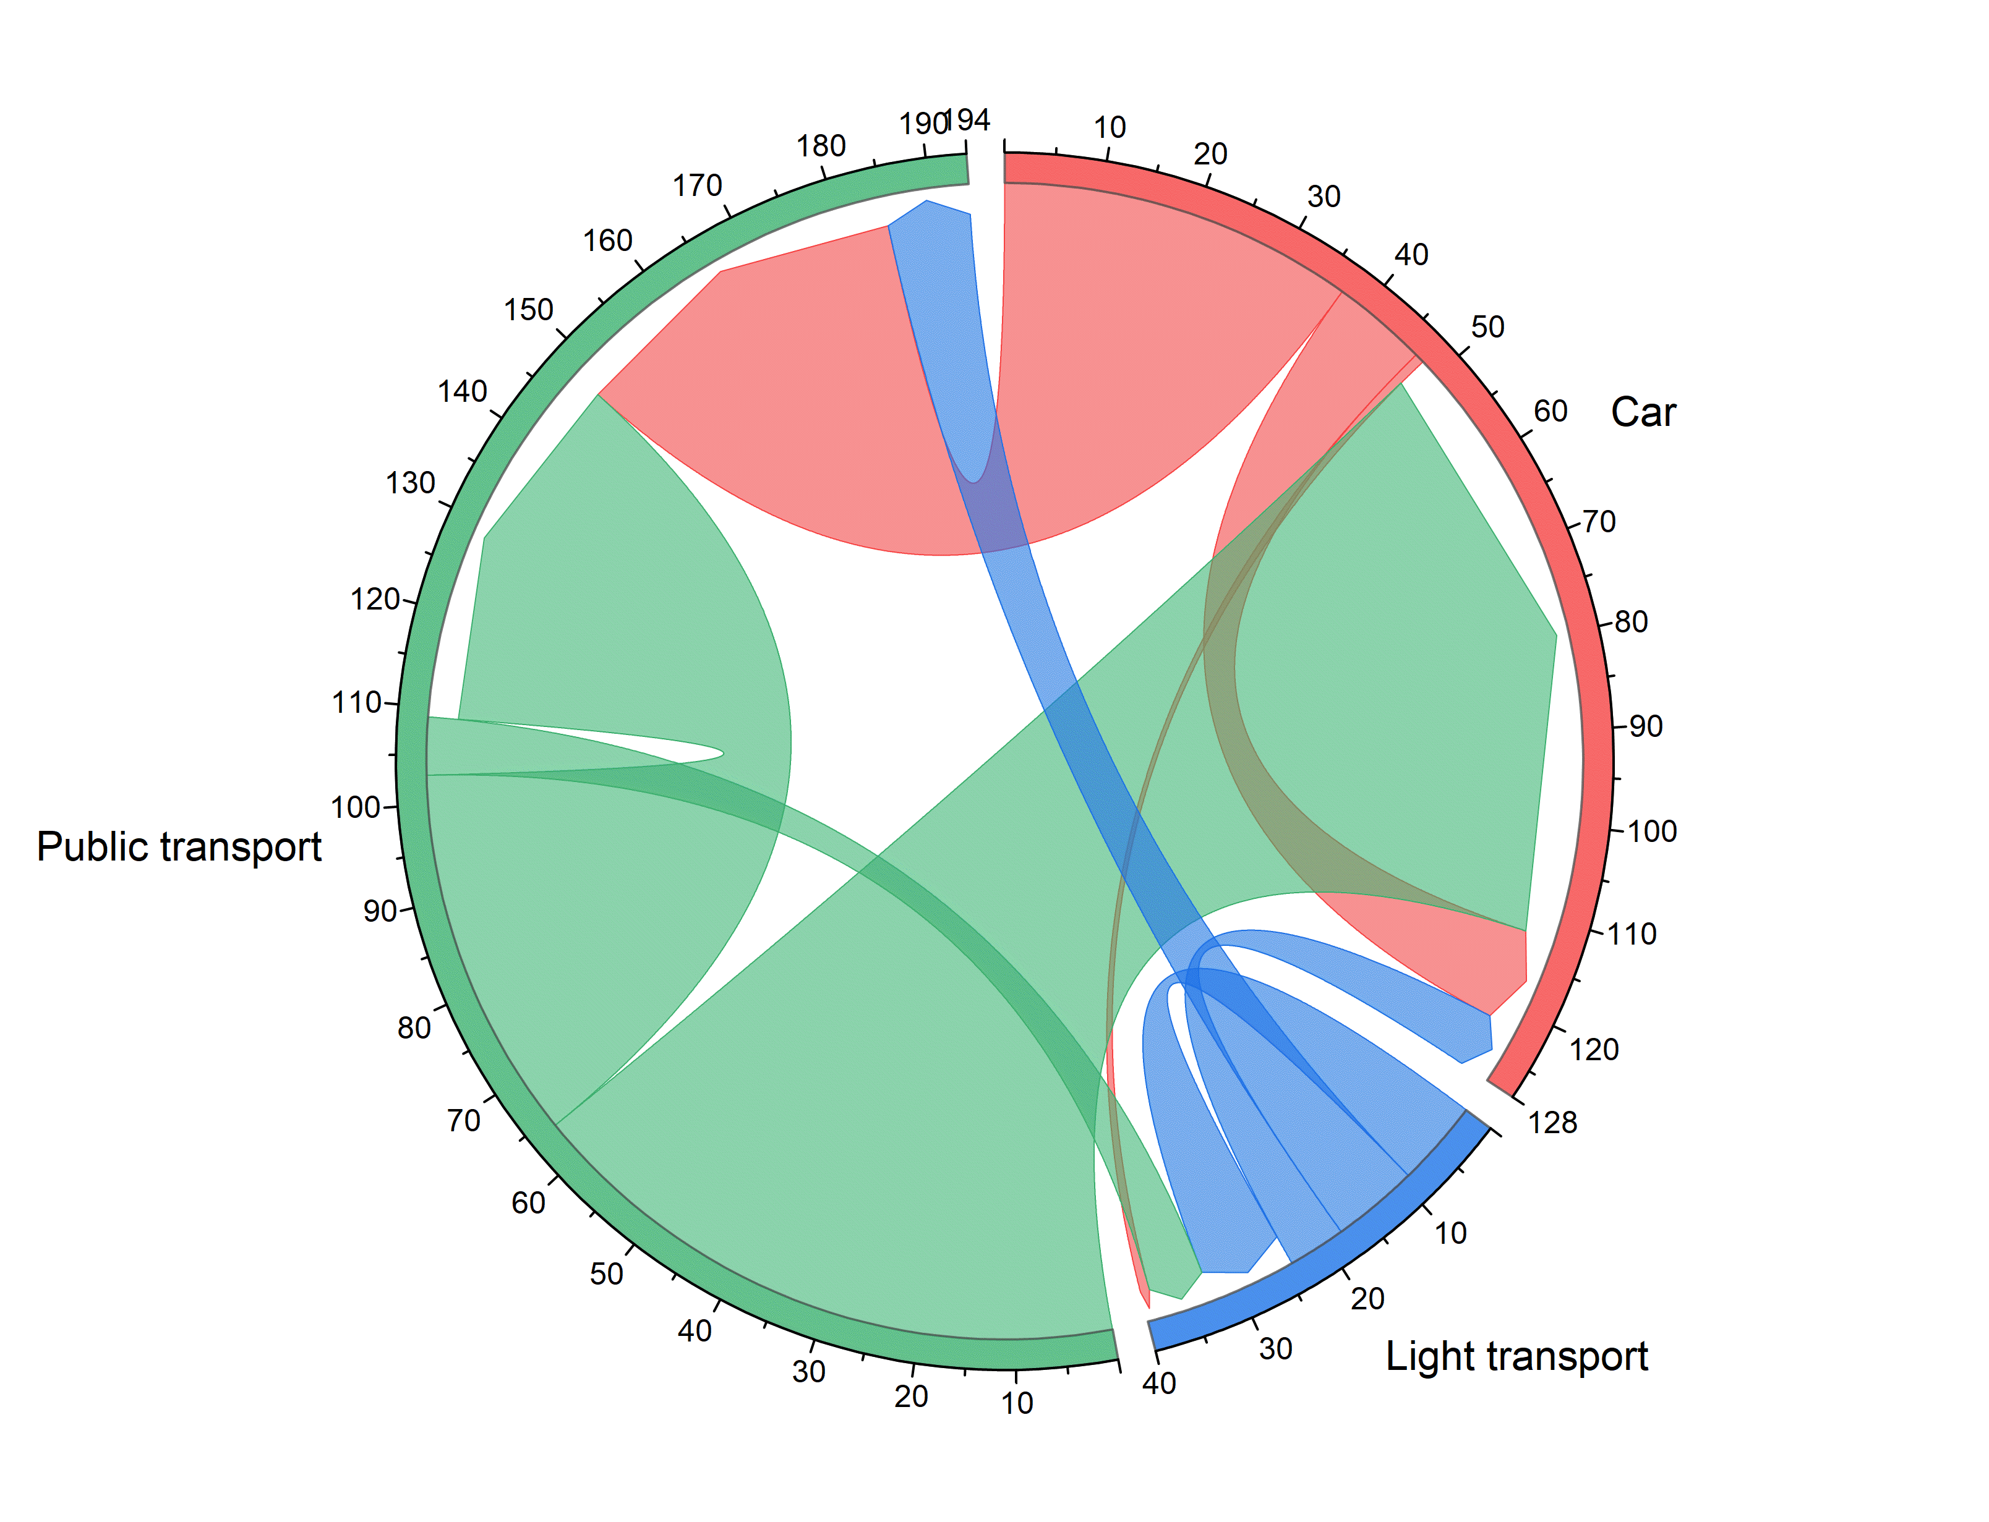
The chord diagram represents the flow between different transport means.
The arrows display the transition between the first alternative (the preferred transport mean) and the second alternative.
We included in the category “Car” the transport modes:
Car (driver)
Car (passenger)
Motorbike
In the category “Light transport” the modes:
Walk
Bike
E-scooter
Other / I have no available alternatives
In the category “Public transport” the modes:
Bus
Metro, tram or light rail
Train
Ferry

Slide 18
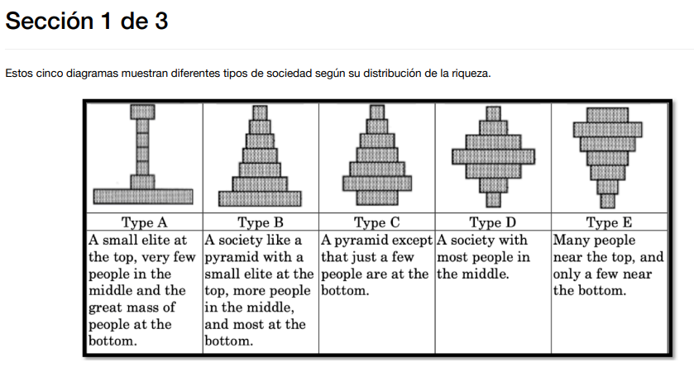

Slide 19
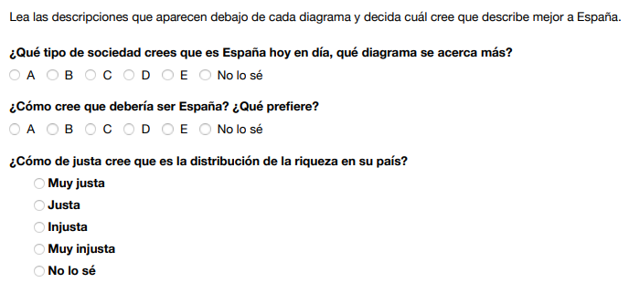
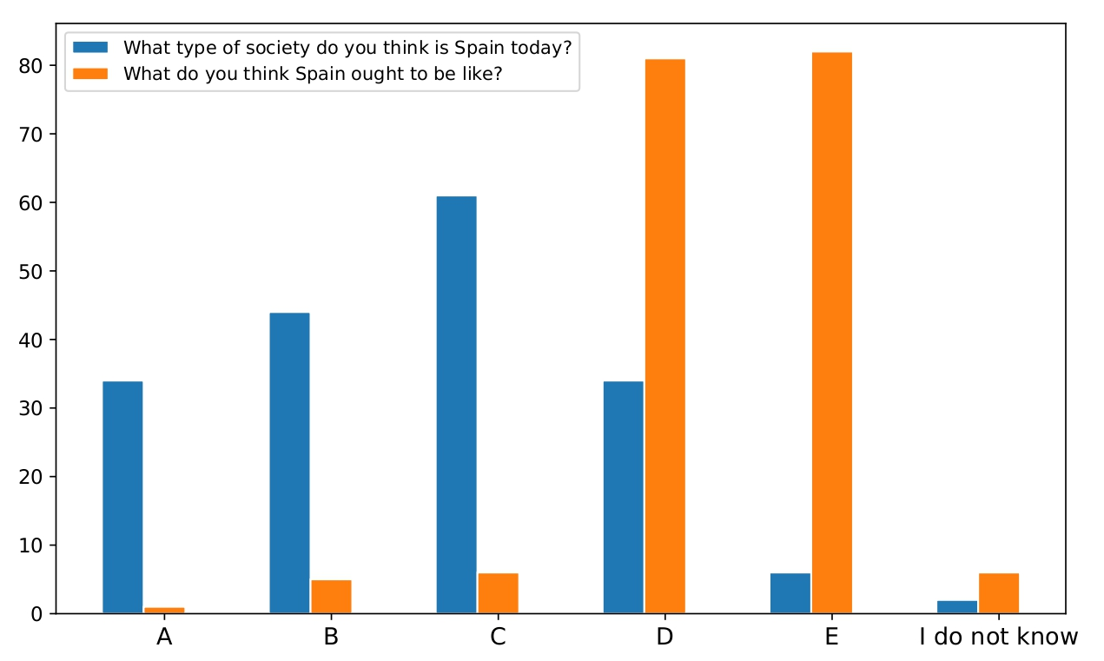

Slide 20
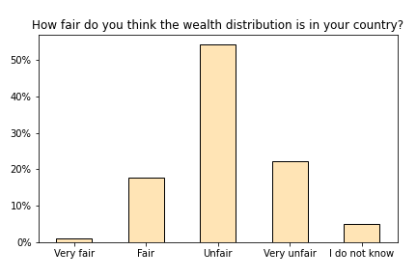

Slide 21
Sec. 2 Choice experiment

Slide 22
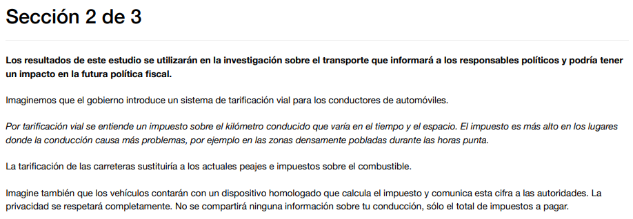

Slide 23
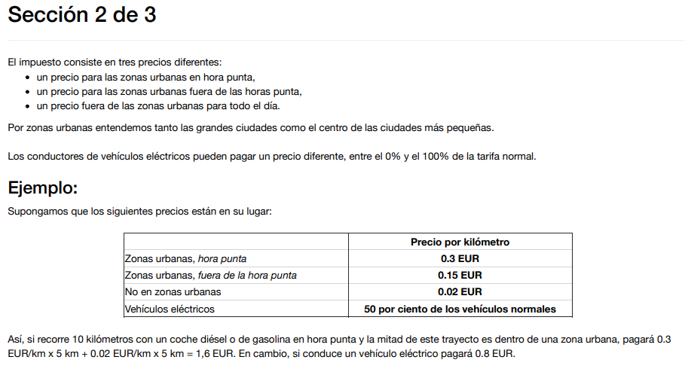

Slide 24
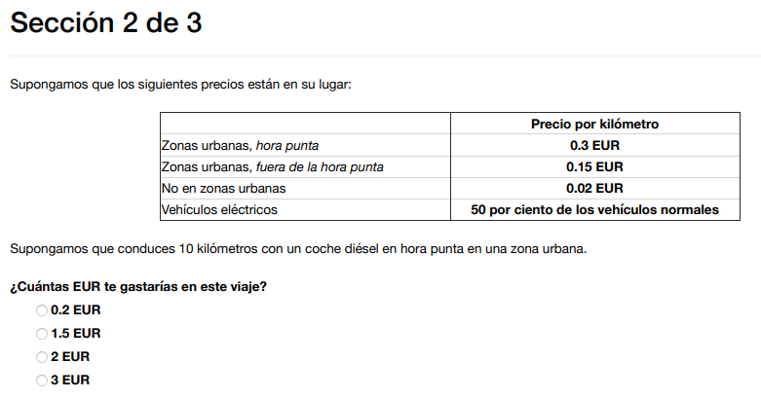
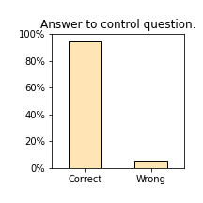
95%

Slide 25


Slide 26

The money raised from the tax can be used in one of the following ways:
General budget: The government will decide how to use the revenue according to its priorities.
Equal cash transfer: The revenue will be distributed equally among all citizens.
Cash transfer for low-income citizens: Revenues will be returned to low-income citizens.
Road investments: Revenues will be used for road investments and maintenance.
Investments in public transport, walking and cycling: Revenues will be used for investments and improvements in public transport, walking and cycling infrastructure and services.

Slide 27

Each participant was asked to order the different ways of reinvestment from the best (Alternative 1) to the worst (Alternative 5).
The plot shows for each “reinvestment type” the percentages of people which chose it as Alternative 1 (in blue), Alternative 2 (orange), up to Alternative 5 (in purple).
To make an example, 50% of people chose “Investments in public transport, walking and cycling” as Alternative 1, and 30% as Alternative 2.

Slide 28

Treatment 2: Congestion and pollution

Slide 29

Treatment 3: Public services

Slide 30

Treatment 4: Redistribution

Slide 31


These screenshots correspond to a participant who was in the treatment Public services

Slide 32


Slide 33


Slide 34


Slide 35


Slide 36


Slide 37
Sec. 3a Social norms

Slide 38

This particular participant is seeing:
‘Private veichle’ as option A, and
‘Public transport, cycling and walking’ as option B
Empirical Expectation
(EE)
Personal Normative belief
(PNB)
Normative expectation
(NE)

Slide 39

What share (in %) of other participants in the survey do you think have chosen one of the transport modes in A for their daily trip?
Empirical expectations (EE)
Percentage of the expected use of car among participants
Both plots show the distribution relative to the option: car
(the distribution of set A is kept the same, while for set B we computed 100% - their answers)
Participants having car as option A
Participants having car as option B

Slide 40

Empirical expectations (EE)
Percentage of the expected use of car among participants
A: Car
Mean: 48.71
Std: 18.18
Total: 91
A: Public transport
Mean: 42.67
Std: 17.97
Total: 90
The actual number of participants using the car (including driver, passenger and motorbike) is 26.52% of all participants
(dashed line in the figure)

Slide 41

In your opinion, what should the ideal percentage of people using transport modes in A for their daily trip be?
Personal Normative belief (PNB)
Percentage of the ideal use of car among participants
Participants having car as option A
Participants having car as option B

Slide 42

Personal Normative belief (PNB)
Percentage of the ideal use of car among participants
A: Car
Mean: 30.98
Std: 21.33
Total: 91
A: Public transport
Mean: 29.09
Std: 20.83
Total: 90
The green dashed line represents the median of the PNB distribution among participants in the group
“Public transport” → 20%
The orange dashed line represents the median of the PNB distribution among participants in the group
“Car” → 25%

Slide 43

What share (in %) of other participants in the survey do you think have mostly chosen option A (answered more than 50%) in the previous question?
Normative expectations (NE)
Percentage of the expected ideal use of car among participants
Participants having car as option A
Participants having car as option B

Slide 44


Normative expectations (NE)
Percentage of the expected ideal use of car among participants
Personal Normative belief (PNB)
A: Car
Mean: 37.65
Std: 29.53
Total: 91
A: Public transport
Mean: 31.40
Std: 28.04
Total: 90
The dashed line (in the fig. on the left) represents the actual number of other participants who have mostly chosen option A (answered more than 50%) in the previous question, which is 17.12% of all participants, calculated by computing the area under the probability density averaged for the two groups (see fig. on the right).

Slide 45



Distribution of the use of public transport
Distribution of the use of car (driver, passenger, motorbike)
Total : 48 people
Total : 133 people

Slide 46
Social norm strenght definition and measurement
We calculate the norm strength in the following way:
The consistency measures how far are the participants’ expectations from one to another.
The accuracy measures how much participants’ expectations (both empirical and normative) “forecast” what the others will do or think that is appropriate to do.
The specificity measures whether the individual’s empirical and normative expectations are close to the group average empirical and normative expectations.

Slide 47


Consistency

Slide 48


Accuracy

Slide 49


Specificity

Slide 50


Norm strength

Slide 51


Even if you answered that you do not have access to a car, imagine that you have it for your daily commute

Slide 52


Imagine that most of the people answering this survey say they use option A to “go to work” and most of them think that other people should also use option A
Scenario HH (High EE, High NE):
Both plots show the distribution relative to the option: car
(the distribution of set A is kept the same, while for set B we computed 100% - their answers)
Participants having car as option A
Participants having car as option B

Slide 53

Scenario HH (High EE, High NE):
A: Car
Mean: 43.63
Std: 35.21
Total: 91
A: Public transport
Mean: 32.66
Std: 29.18
Total: 90

Slide 54

Scenario HL (High EE, Low NE):
Imagine that most of the people answering this survey say they use option A to “go to work” and few of them think that other people should use option A
Participants having car as option A
Participants having car as option B

Slide 55

Scenario HL (High EE, Low NE):
A: Car
Mean: 40.99
Std: 33.20
Total: 91
A: Public transport
Mean: 30.38
Std: 28.04
Total: 90

Slide 56

Scenario LH (Low EE, High NE):
Imagine that few of the people answering this survey say they use option A to “go to work” and most of them think that other people should use option A
Participants having car as option A
Participants having car as option B

Slide 57

Scenario LH (Low EE, High NE):
A: Car
Mean: 40.90
Std: 32.98
Total: 91
A: Public transport
Mean: 33.01
Std: 29.08
Total: 90

Slide 58

Scenario LL (Low EE, Low NE):
Imagine that few of the people answering this survey say they use option A to “go to work” and few of them think that other people should use option A
Participants having car as option A
Participants having car as option B

Slide 59

Scenario LL (Low EE, Low NE):
A: Car
Mean: 42.75
Std: 35.23
Total: 91
A: Public transport
Mean: 29.33
Std: 27.90
Total: 90

Slide 60
HH
HL
LH
LL

Slide 61

Conditional choice per treatment
We plot the average of the answers of the participants in each question (conditional choice).
However, 99 people (54.7%) answered the same percentage in the 4 questions HH, HL, LH, LL,
And 121 people (66.9%) answered the same percentage in the questions HL, LH

Slide 62

Analysis of behavioral typology
The four conditional choices can be summarized into two measures of responsiveness to empirical and normative expectations: Empirical Expectation Influence (EEI), which represents subjects’ sensitivity to empirical expectations, and Normative Expectation Influence (NEI), which represents subjects’ sensitivity to normative expectations.

Slide 63

Treatment 1: No treatment

Slide 64

Treatment 2: Congestion and pollution

Slide 65

Treatment 3: Public services

Slide 66

Treatment 4: Redistribution

Slide 67
Sec. 3b Socio-demographics

Slide 68




Slide 70



Slide 71


Slide 72

How much do you personally trust the following institutions from 1 to 7, where 1 means ‘No trust at all’ and 7 means ‘Trust compltely’ ?

Slide 73



Slide 74


Slide 75

How much do you agree with the following statements from 1 to 7, where 1 means ‘I completely disagree’ and 7 means ‘I completely agree’?

Slide 76


How much do you agree with the following statements from 1 to 7,
where 1 means ‘I completely disagree’ and 7 means ‘I completely agree’?
Population in each category:
No information: 42 people
Congestion and pollution: 40 people
Public services: 48 people
Redistribution: 51 people

Slide 77


Slide 78


Slide 79


Slide 80


